Slide 1
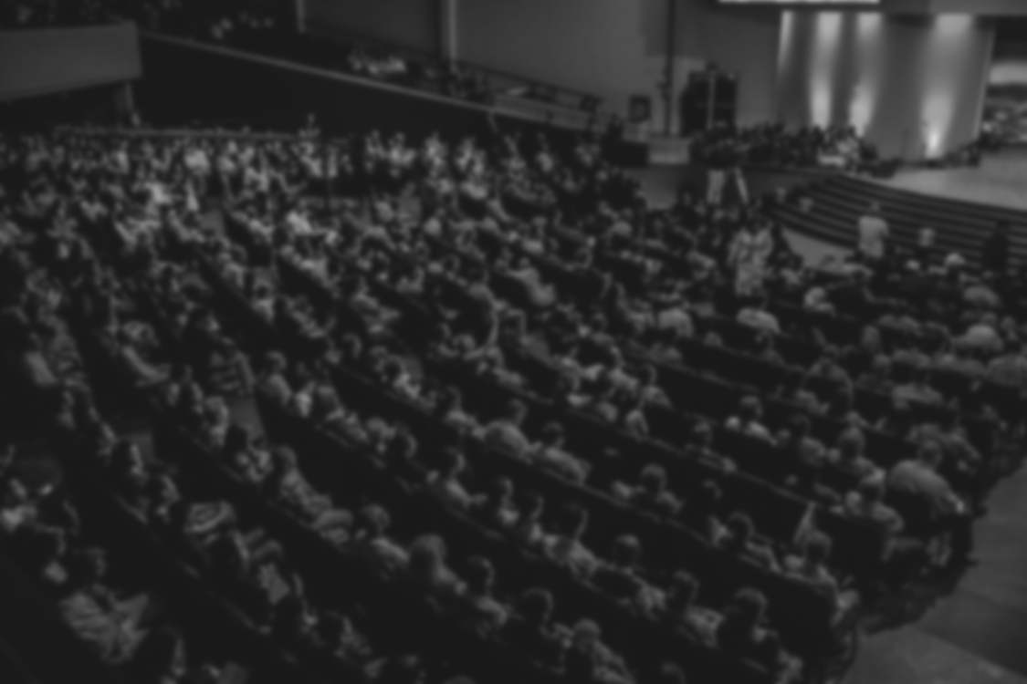
Precision Object Counting System
DEPARTMENT OF CSE-ARTIFICIAL INTELLIGENCE AND MACHINE LEARNING
BATCH : 2020-2024
MAJOR PROJECT
Team Members :
G. Chakrapani (20D41A6620)
B. Divya (20D41A6609)
V. Likitha (20D41A6660)
A. Rishikesh Shivadhar Reddy (20D41A6604)
Under the Guidance of:
Mrs. Sandhya Bolla
(Associate Professor)

Slide 2
Abstract
State Of The Art
Existing System
Proposed System
Advantages Of Proposed System
Modules Description
Analysis
System Architecture & Diagrams
Input
Output
Contents

Slide 3
Abstract
The project presents an advanced approach for counting objects, specifically focusing on people, within images. By leveraging computer vision techniques, including image preprocessing, segmentation, and contour analysis, the system accurately identifies and counts individuals in diverse scenarios. Unlike traditional methods, which often face challenges in complex environments, our proposed system demonstrates robustness and adaptability. Through a series of modular processing steps, the system achieves enhanced accuracy and efficiency in object counting tasks. This project offers a practical solution for applications such as surveillance, crowd management, and traffic monitoring, providing valuable insights for real-world scenarios.

Slide 4
State of the Art
Traditional object counting systems have long relied on simplistic methods, often struggling with accuracy and adaptability in diverse environments. While basic techniques like thresholding and contour detection have been employed, they falter in complex scenarios. Modern advancements in computer vision and image processing, however, have paved the way for more sophisticated approaches. Our project leverages state-of-the-art methodologies, including adaptive histogram equalization, Otsu's thresholding, and dilation/erosion operations, to achieve precise object counting. By integrating these techniques, our system surpasses conventional methods, offering robustness and versatility for applications such as surveillance, crowd analysis, and urban planning.

Slide 5
Existing System
Traditional object counting systems typically rely on basic image processing techniques such as thresholding and contour detection. These methods involve simple algorithms to separate objects from the background and identify their boundaries. However, they often lack precision and struggle in scenarios with varying lighting conditions or complex backgrounds. Moreover, these systems may require manual calibration and parameter tuning, making them less efficient for real-time applications. Existing systems tend to exhibit limited accuracy and scalability, hindering their effectiveness in tasks such as crowd monitoring, traffic analysis, and event management. Thus, there is a clear need for more advanced approaches to improve object counting accuracy and robustness.

Slide 6
Proposed System
Our proposed object counting system represents a significant advancement over traditional methods, incorporating state-of-the-art image processing techniques to achieve superior accuracy and robustness. By harnessing advanced algorithms such as adaptive histogram equalization, Otsu's thresholding, and dilation/erosion operations, our system is capable of effectively handling complex scenarios with varying lighting conditions and background clutter. This allows for more precise segmentation and counting of objects, particularly in crowded or challenging environments. Furthermore, the modular design of our system facilitates scalability and customization, making it adaptable to a wide range of applications including surveillance, crowd management, and traffic analysis. Our proposed system represents a paradigm shift in object counting technology, offering unparalleled performance and versatility.

Slide 7

Advantages of Proposed System
1
Robust performance in diverse environments with varying lighting conditions and background complexities, ensuring reliable object detection and counting.
3
Combining sophisticated image processing techniques including Otsu's thresholding and adaptive histogram equalization.
2
Modular design, our system offers flexibility for customization, allowing users to adapt processing steps and parameters according to specific application requirements.
Enhanced Accuracy
Robustness to Varied Conditions
Flexibility and Customizability
The system provides a comprehensive analysis of images, including preprocessing, segmentation, and contour analysis, leading to thorough and accurate object counting results.
6
4
5
The system's architecture allows for scalability, enabling it to handle large volumes of data and adapt to evolving requirements, ensuring longevity and sustainability in deployment scenarios.
Our system offers ease of integration with existing workflows or systems, facilitating seamless adoption and integration into various applications.
Comprehensive Analysis
Ease of Integration
Scalability

Slide 8
Modules Description
Segmentation and Thresholding
(Otsu’s Thresholding)
Object Counting and Labelling
(Contour Labelling)
Morphological Operations
(Dilation, Erosion, Median Filtering)
Results Visualization and Reporting
Region Cropping and Resizing
Image Enhancement and Correction
(Gamma Correction, Histogram Equalization)
Image Loading and Preprocessing

Slide 9
Analysis

Slide 10






System Architecture
Image Upload & Processing
Preprocessing
Apply Process Methods
Show Results
Count the Labels (People)
Tag Labels to objects & People

Slide 11
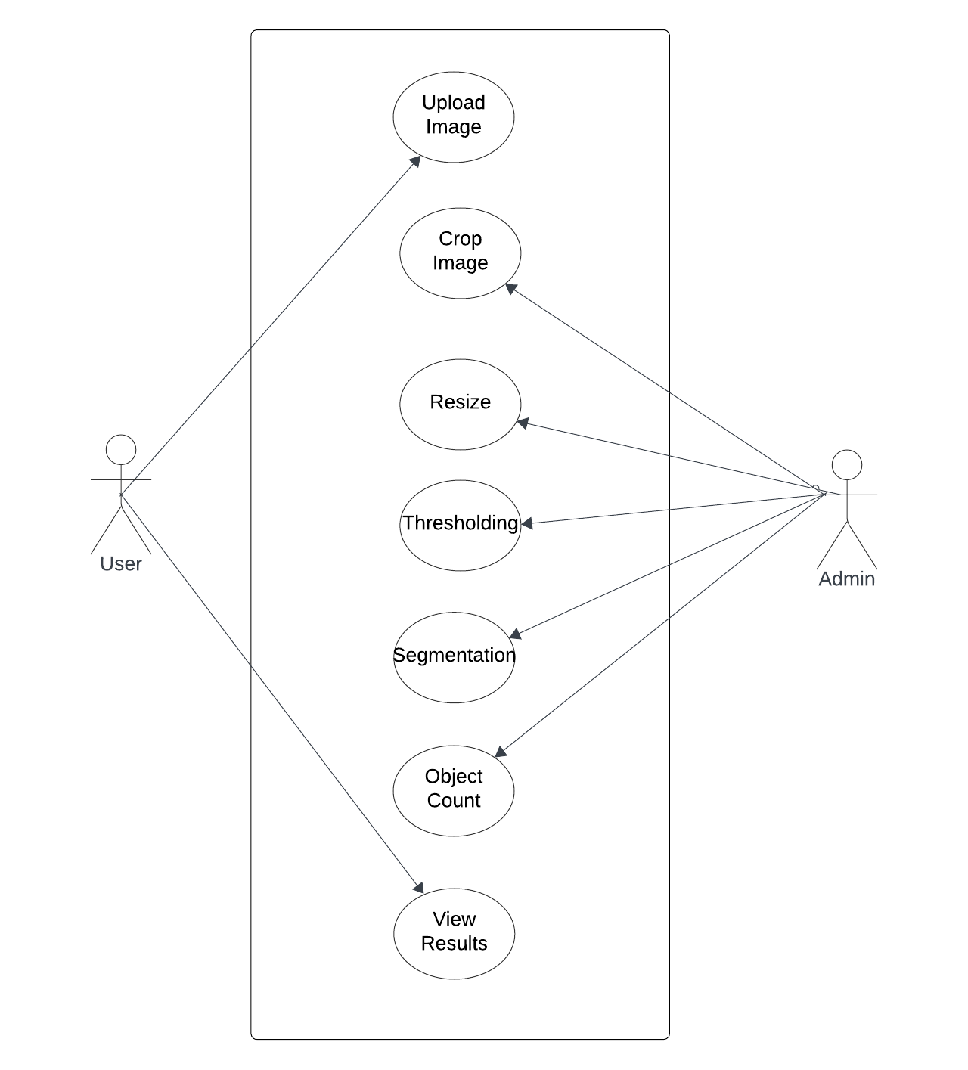
Use Case
Diagram

Slide 12
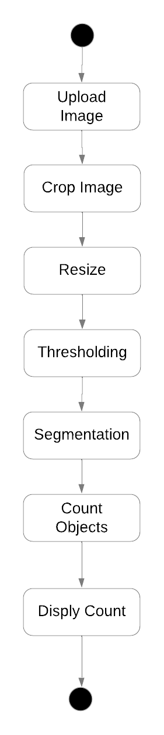
Activity
Diagram

Slide 13
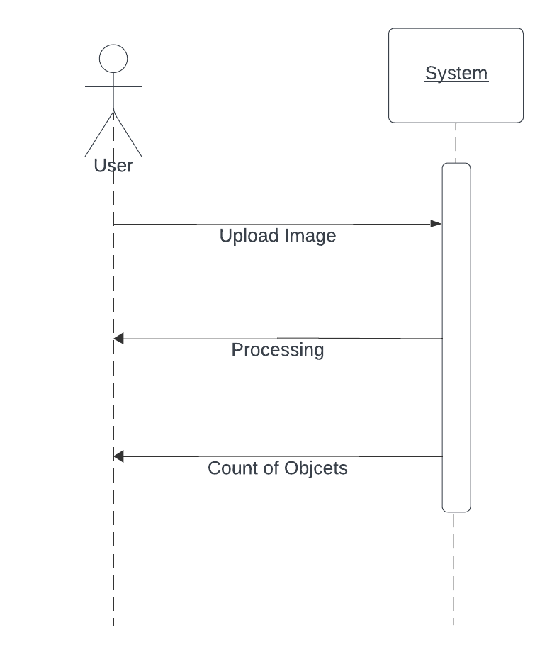
Sequence
Diagram

Slide 14
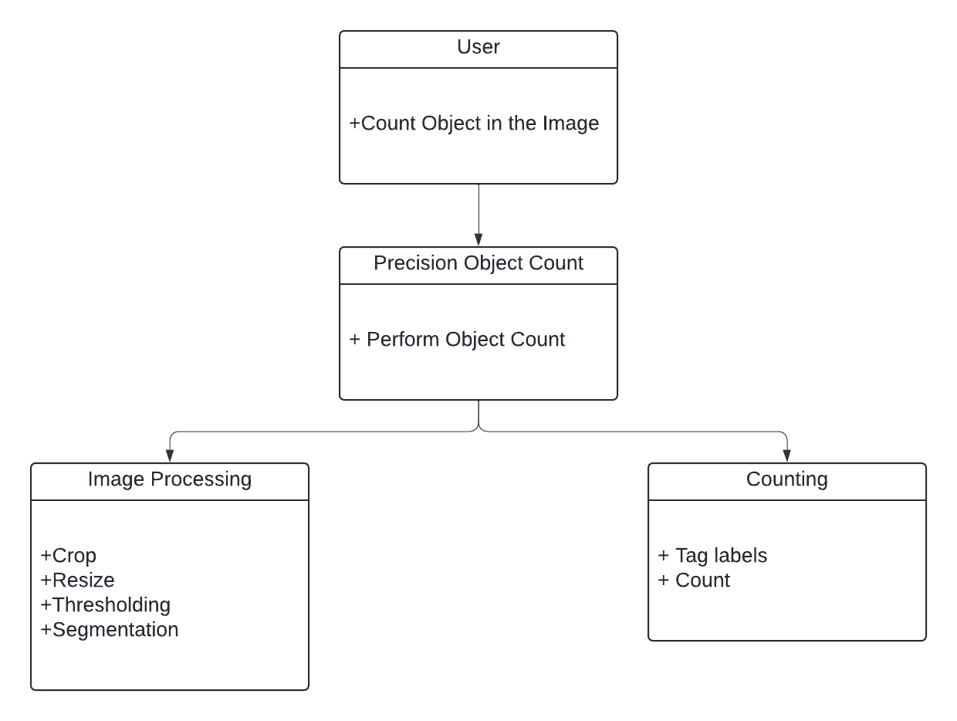
Class
Diagram

Slide 15
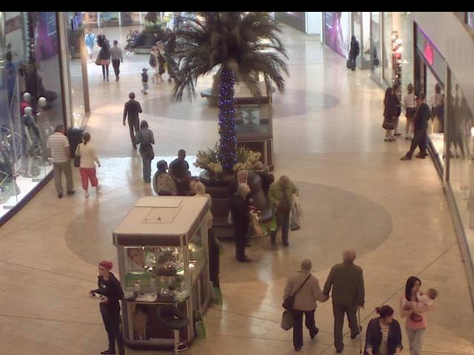
Input

Slide 16
Code
import cv2
import matplotlib.pyplot as plt
import numpy as np
def plotting_grid(images, titles, rows, cols, figsize):
fig, axes = plt.subplots(rows, cols, figsize=(figsize, figsize))
for i, ax in enumerate(axes.flat):
ax.imshow(images[i], cmap='gray', vmin=0, vmax=255, interpolation='none')
ax.set_title(titles[i])
ax.set_xticks([]), ax.set_yticks([])
def crop(image, start_y, end_y, start_x, end_x):
img_cropped = image[start_y:end_y, start_x:end_x]
return img_cropped
def resize(image, width, height):
img_resized = cv2.resize(image, (width, height))
return img_resized
def gamma_correction(image, y):
gamma_correct = np.array(255 * (image / 255) ** y, dtype='uint8')
return gamma_correct
def adaptive_histogram_equalization(image):
clahe = cv2.createCLAHE(clipLimit=2.0, tileGridSize=(8, 8))
img_equalized = clahe.apply(image)
return img_equalized

Slide 17
def otsu_threshold(image):
_, img_thresh = cv2.threshold(image, 0, 255, cv2.THRESH_BINARY + cv2.THRESH_OTSU)
return img_thresh
def dilation_erosion(image):
kernel = np.ones((15, 15), np.uint8)
img_dilation = cv2.dilate(image, kernel, iterations=1)
img_erode = cv2.erode(img_dilation, kernel, iterations=1)
img_erode = cv2.medianBlur(img_erode, 7)
return img_erode
def labeling(image):
contours, _ = cv2.findContours(image, cv2.RETR_EXTERNAL, cv2.CHAIN_APPROX_SIMPLE)
labeled_img = cv2.drawContours(np.zeros_like(image), contours, -1, (255), thickness=cv2.FILLED)
count = len(contours)
plt.title('People counted in this image: ' + str(count))
plt.imshow(labeled_img, cmap='gray')
plt.show()
return count
image_paths = [ '/content/drive/MyDrive/object count in images/code/frames/frames/seq_000001.jpg']
total_people_count = 0

Slide 18
for i, img_path in enumerate(image_paths):
img = cv2.imread(img_path, cv2.IMREAD_GRAYSCALE)
if img is None:
print(f"Error: Unable to load image at path: {img_path}")
continue
cropped_images, cropped_titles = [], []
for j, (start_y, end_y, start_x, end_x) in enumerate([(100, 380, 380, 600), (20, 220, 100, 300), (200, 500, 0, 300)]):
cropped_img = crop(img, start_y, end_y, start_x, end_x)
cropped_images.append(cropped_img)
cropped_titles.append(f'Image {i + 1}-{chr(ord("A") + j)} (Cropped)')
all_images = [img] + cropped_images
all_titles = [f'Image {i + 1}'] + cropped_titles
plotting_grid(all_images, all_titles, 1, len(all_images), 18)
processed_images, processed_titles = [], []
for j, cropped_img in enumerate(cropped_images):
multiplier = 2
resized_img = resize(cropped_img, cropped_img.shape[1] * multiplier, cropped_img.shape[0] * multiplier)
gamma_value = [1.2, 0.5, 2.5][j]
gamma_corrected_img = gamma_correction(resized_img, gamma_value)

Slide 19
blurred_img = cv2.GaussianBlur(gamma_corrected_img, (5, 5), 0)
equalized_img = adaptive_histogram_equalization(blurred_img)
thresholded_img = otsu_threshold(equalized_img)
dlt_er_img = dilation_erosion(thresholded_img)
processed_images.extend([resized_img, gamma_corrected_img, blurred_img, equalized_img, thresholded_img, dlt_er_img])
processed_titles.extend([
f'Resized Image {i + 1}-{chr(ord("A") + j)}',
f'Gamma Image {i + 1}-{chr(ord("A") + j)}',
f'Blurred Image {i + 1}-{chr(ord("A") + j)}',
f'Equalized Image {i + 1}-{chr(ord("A") + j)}',
f'Thresholded Image {i + 1}-{chr(ord("A") + j)}',
f'Dilatation and Erosion Image {i + 1}-{chr(ord("A") + j)}'])
plotting_grid(processed_images, processed_titles, len(cropped_images), 6, 18)
total_people_count += labeling(dlt_er_img)
print(f'Total people counted across all images: {total_people_count}')

Slide 20
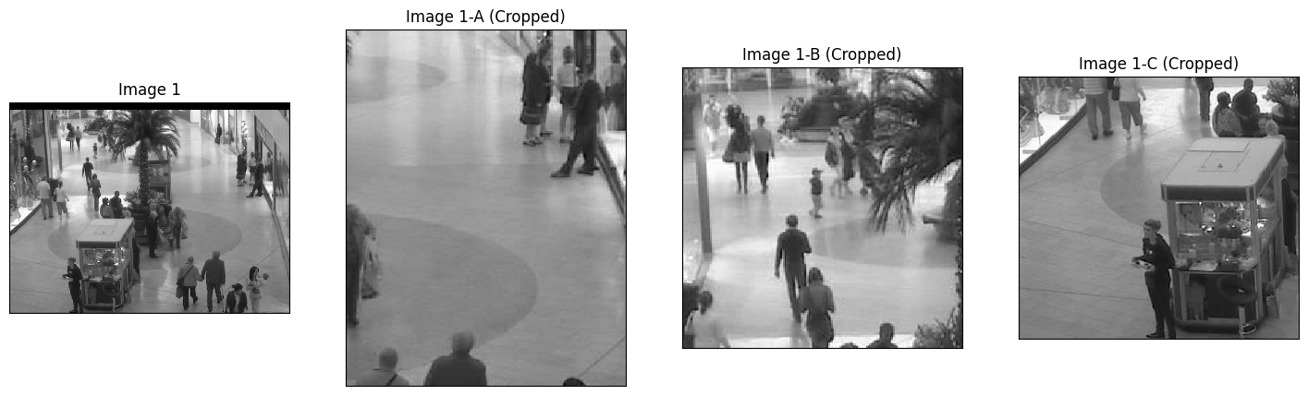
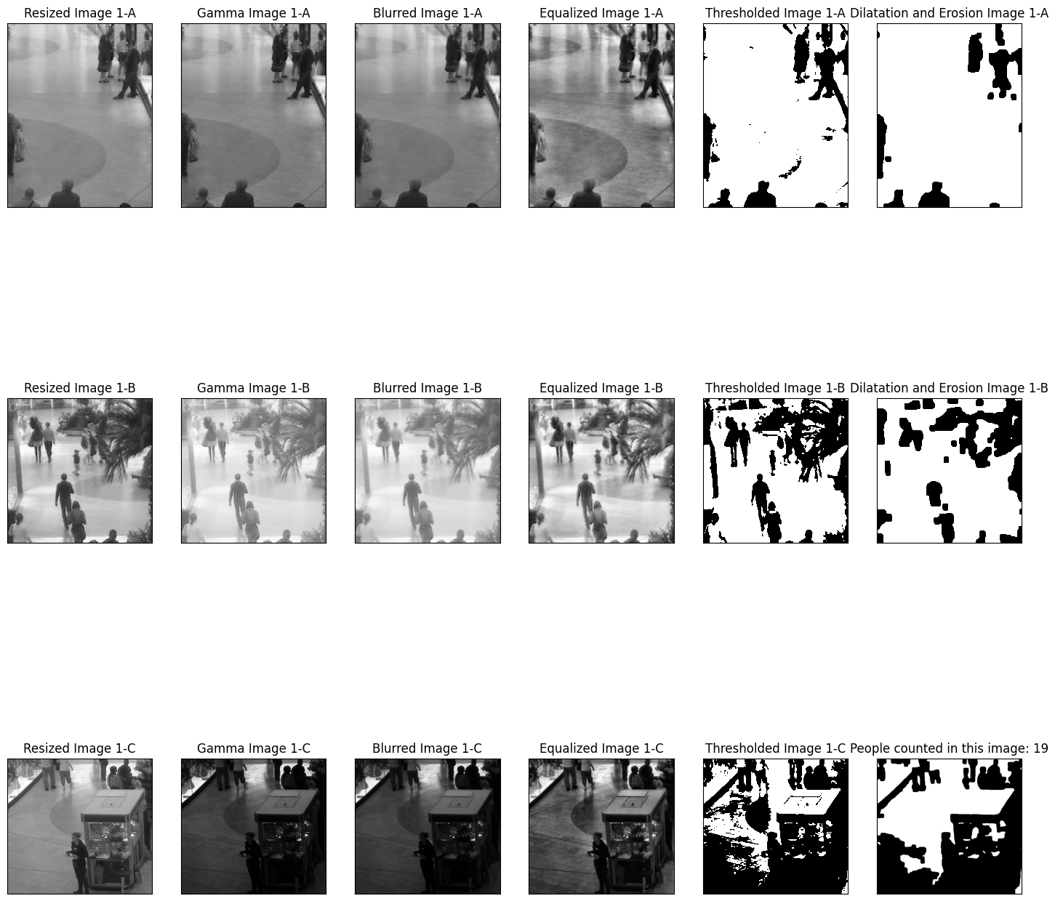
Output

Slide 21
Total people counted across all images: 19

Slide 22
Conclusion
In conclusion, the Precision Object Counting System project leverages image processing techniques to accurately detect and count objects in uploaded images. By implementing algorithms such as cropping, gamma correction, adaptive histogram equalization, Otsu's thresholding, dilation, and erosion, the application effectively preprocesses images for object detection. Despite encountering technical challenges such as index errors, continuous improvement and error handling ensure robustness. Through this project, valuable insights into image processing methodologies and their application in real-world scenarios are gained, paving the way for further advancements in computer vision and object detection technologies.

Slide 23
THANK YOU

